Slide 1

BigMart Sales Prediction
Author Name ::
Saeed Afrough
October 2023

Slide 2
Agenda :
Introduction
Objectives
Data Overview
Data Exploration
Model Building
Model Evaluation
Conclusion

Slide 3

Introduction :
The data scientists at BigMart have collected 2013 sales data for numerous products across many stores in different cities. Also, certain attributes of each product and store have been defined.

Slide 4
Objectives :
Using this model, BigMart will try to understand the properties of products and stores which play a key role in increasing sales.
Build a predictive model and find out the sales of each product at a particular store.

Slide 5
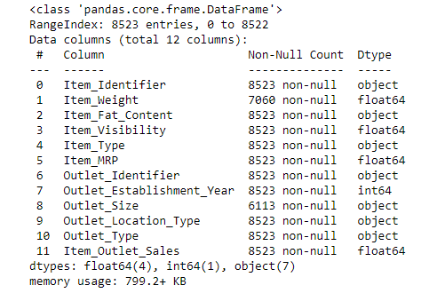
8523
12
2
About Dataset :
Rows
Features
Features with missing value

Slide 6
Exploratory Data Analysis

Slide 7
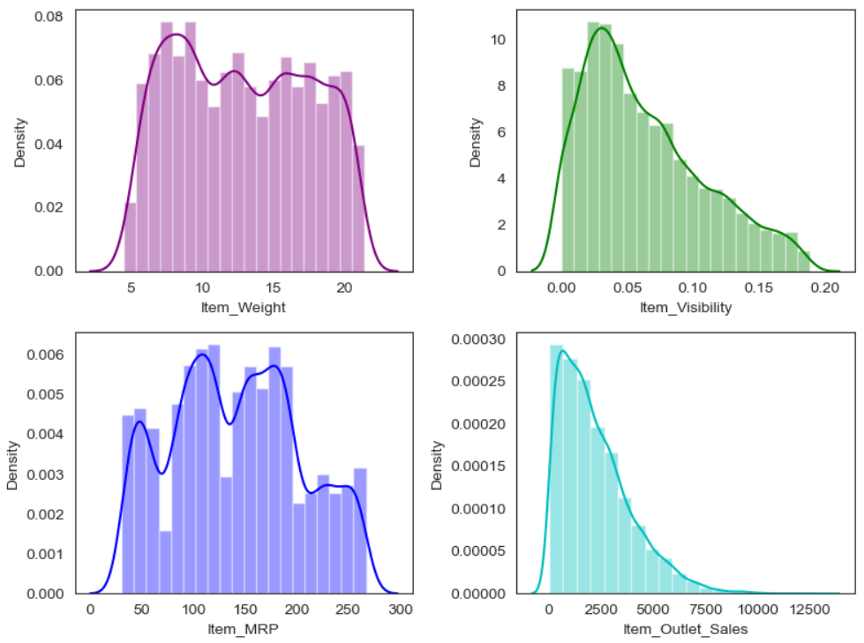
Univariate Analysis
The distribution of Item_Weight is relatively consistent, except for a notable surge when the weight is 13g.
The shapes of Item _ Visibility and Item _ Outlet _ Sales closely resemble each other. It's evident that the placement of the item significantly influences sales, with sales decreasing as the placement moves further away.
Item _ MRP exhibits significant fluctuations, indicating a substantial price difference between items.

Slide 8
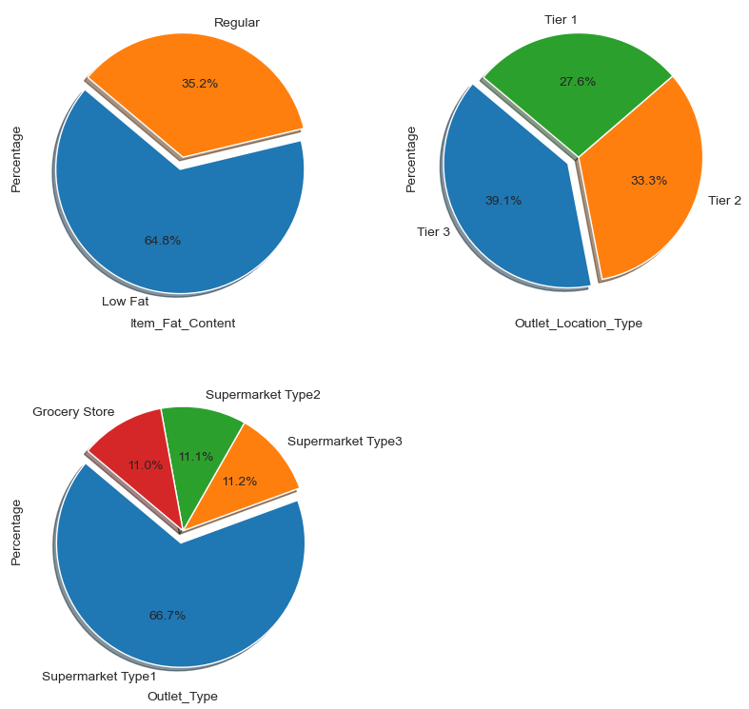
Univariate Analysis

Slide 9
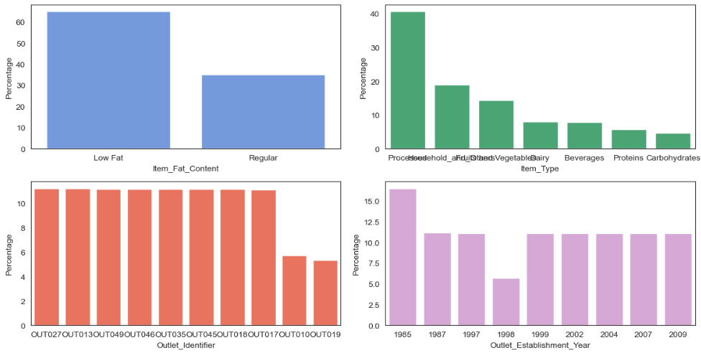
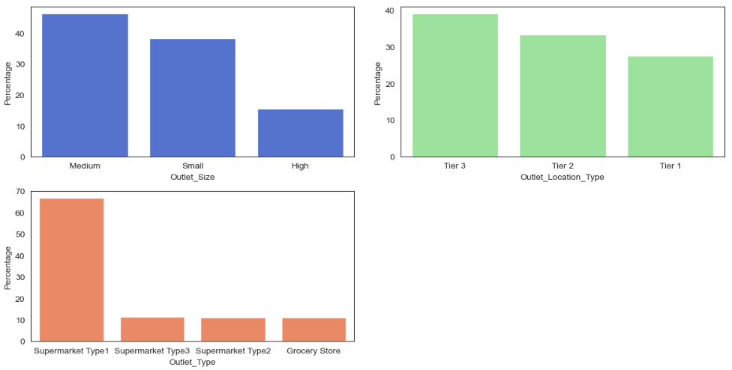
Univariate Analysis

Slide 10
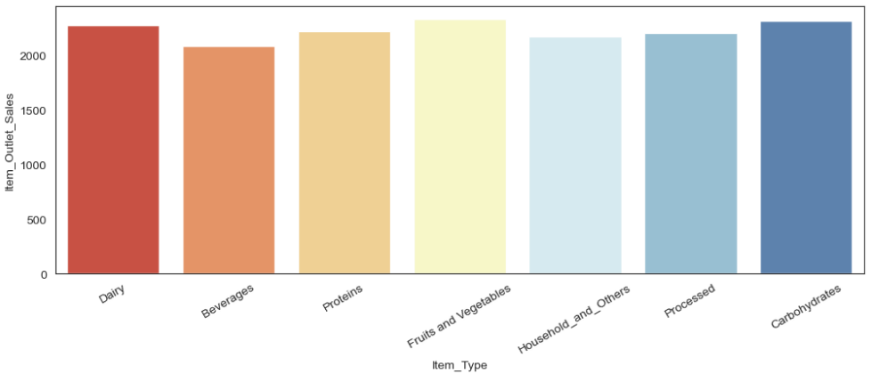
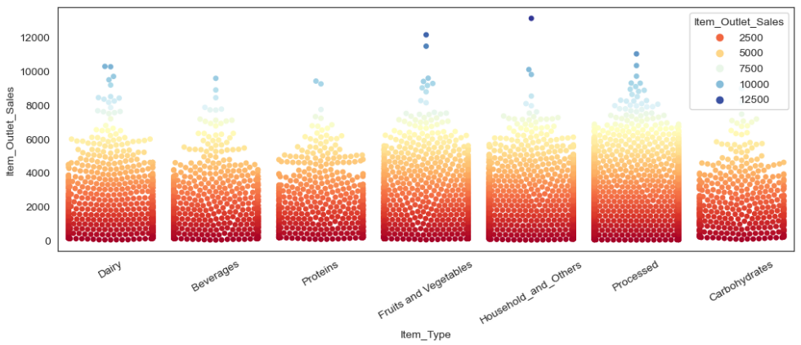
Bi-ivariate Analysis
There is not much difference in sales between item types.

Slide 11
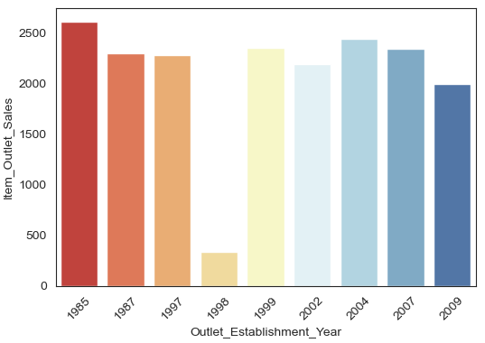
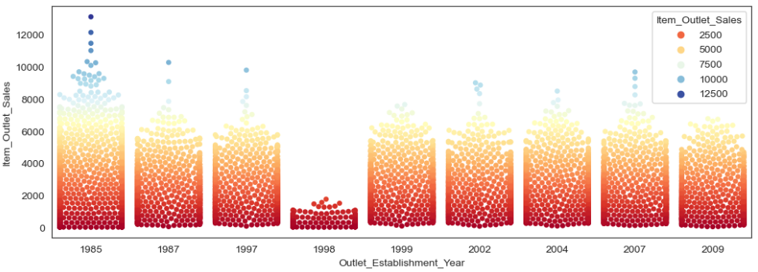
Bi-variate Analysis
Sales were roughly the same in each year, with only 1998 having unusually low sales.
Referring to the frequency in 1998, the number of outlets established in 1998 was very small, resulting in very low sales.

Slide 12
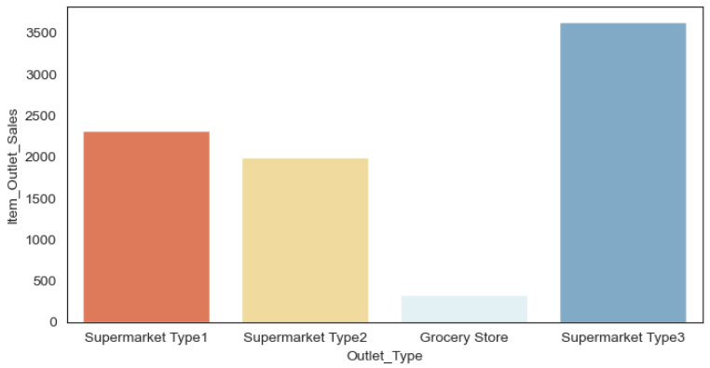
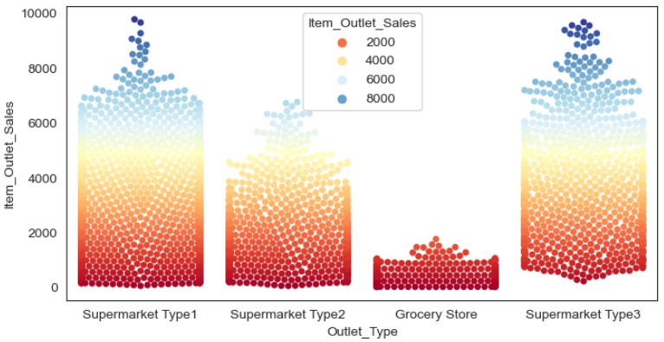
Bi-variate Analysis
The one with the highest sales is supermarket Type3.
Maybe supermarket Type3 is a high-end imported supermarket, and supermarket Type1 is an affordable ordinary supermarket.

Slide 13
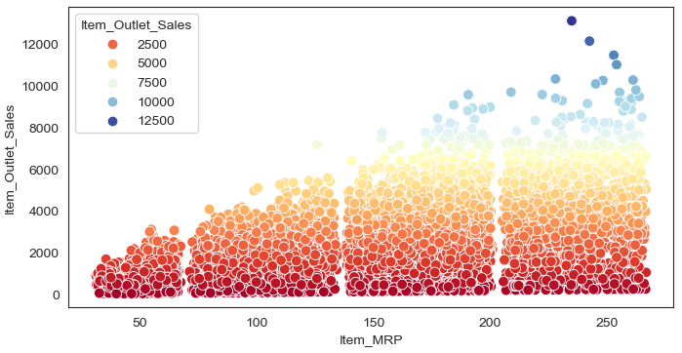
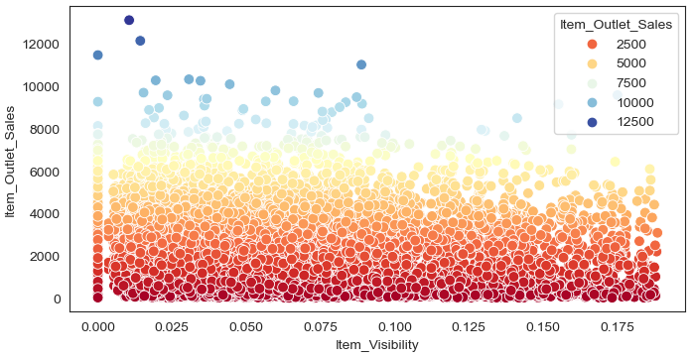
Bi-variate Analysis
d
As the item MRP increases, item sales also increase significantly.
Most items are placed far away. Therefore, sales are generally higher than those in the front area.
.

Slide 14
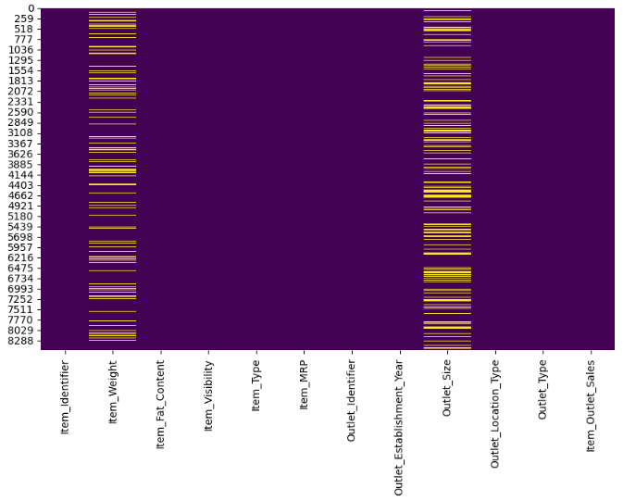
Data Preprocessing
1 - manage duplicated values :
Data set had 0 duplicated variables
2 – Missing Values :
2 columns had missing value :
Item_Weight (Numerical with 1463 missing values ):
We Imputed missing data using KNN imputer
Outlet_Size (Categorical 2410 missing values ) :
We imputed missing value using RandomForest Classifier

Slide 15
Standardized data :
Certain features required standardization, including Item_Fat_Content and item_type .
Given the diverse range of item types, we opted to categorize them into five distinct groups.
Handling Outliers
We removed all extreme and potential outliers, resulting in the exclusion of a total of 161 observations.

Slide 16
Encoding Data :
We employed the Dummies method to encode all categorical features in a two-phase approach.
In the first phase, we encoded all features except for Item_Weight. This exception was made because we needed Item_Weight as the target variable for applying RandomForest Classification to impute missing values.
In the second phase, after completing the imputation, we proceeded to encode Item_Weight.
Scaling Data :
After encoding the data, we utilized the Standard Scaler to normalize all features, ensuring a consistent scale across the dataset.
The final dataset has 5852 observations and 17 columns

Slide 17
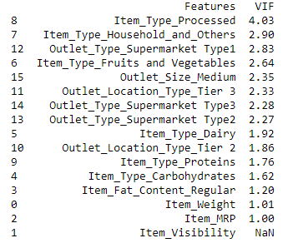
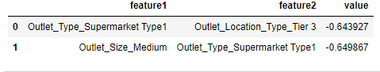
Feature Selection
After Recursive Feature Elimination (RFE), plotting results showed minimal impact on the model score when removing features. The change was only slight, by a few hundredths. Therefore, we decided to retain all columns, as their removal doesn't seem to offer substantial benefits.
We conducted VIF analysis and dropped a feature with a VIF exceeding 5 (Item_small_size ).
We assessed the intercorrelation between features, using a threshold of 0.6. As a result, one feature, namely Outlet_Type_Supermarket_Type1, was dropped

Slide 18
Model Selection
We opted to implement a regression model on two datasets. The first dataset includes the original 17 features, while the second dataset comprises 15 features after removing 2 features due to considerations related to VIF and intercorrelation.
We decided to apply regression model on two datasets , one with 17 original features and one with 15 features after dropping 2 features due to VIF and intercorrelation
In total, we applied 29 models to both datasets.
Additionally, we applied a single model after performing backward elimination with 7 features .

Slide 19
Model Hyperparameter Tuning
Random Forrest Regressor :
After tuning the Random Forest Regressor algorithm for dataset with 17 features , the optimal hyperparameters were determined to be
{'max_depth': 5, 'min_samples_split': 5, 'n_estimators': 8}.
Dataset with 15 features , the optimal hyperparameters were determined to be
{'max_depth': 5, 'min_samples_split': 10, 'n_estimators': 15}.
Optimised Random Forrest Regressor :
For both dataset with 17 and 15 features , the optimal hyperparameters were determined to be
max_depth=10, min_samples_split=10, n_estimators=24, random_state=0

Slide 20
Model Hyperparameter Tuning
AdaBoostRegressor :
For both dataset with 17 and 15 features , the optimal hyperparameters were determined to be
estimator=DecisionTreeRegressor(max_depth=4), n_estimators=10
xgboost :
For both dataset with 17 and 15 features , the optimal hyperparameters were determined to be
colsample_bytree = 0.3, learning_rate = 0.1, max_depth = 5, alpha = 10, n_estimators = 10
Tuned XGBoost :
For both dataset with 17 and 15 features , the optimal hyperparameters were determined to be
max_depth=10, min_samples_split=10, n_estimators=24, random_state=0

Slide 21
Interpretation & Summary

Slide 22
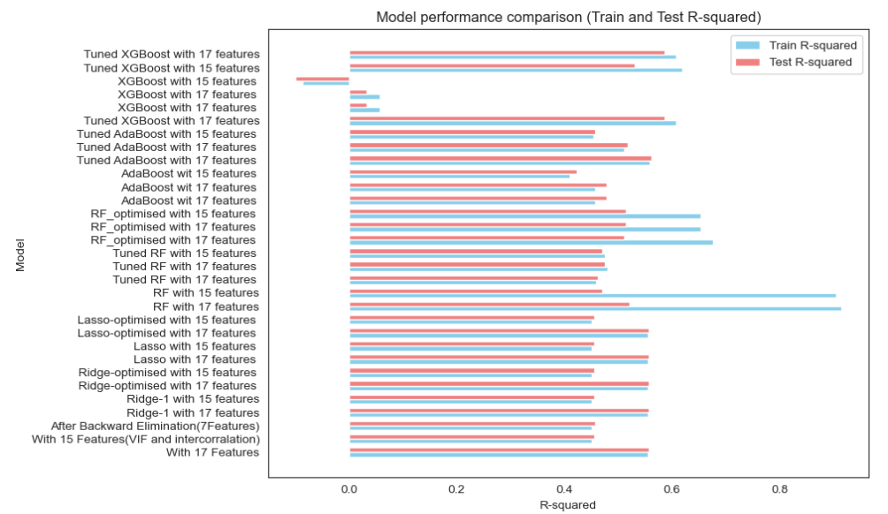

Slide 23
Summary
Models like AdaBoost (22, 23) and Tuned XGBoost (25, 29) seem to strike a good balance between training and test performance. Models like Random Forest (11-18) and some versions of XGBoost (26-28) exhibit overfitting. Ridge and Lasso regularization don't seem to significantly impact the models. Feature selection strategies (Models 0-2) show mixed results, with potential for improvement. It's essential to further fine-tune hyperparameters and consider feature engineering to improve model performance and mitigate overfitting or underfitting. Additionally, cross-validation results should be carefully considered to ensure the robustness of the models.

Slide 24
Overfitted Models :
1
Random Forest (RF) with 17 features (Model 11): Train R-squared : 0.9147 Test R-squared : 0.5216
2
Random Forest (RF) with 15 features (Model 12): Train R-squared : 0.9057 Test R-squared : 0.4710

Slide 25
Model Selection Considerations
Tuned XGBoost with 17 features (Model 25):
Tuned AdaBoost with 17 features (Model 22)
34%
High Train R-squared: 0.6072 Test R-squared: 0.5872
Train R-squared: 0.5592 Test R-squared: 0.5615
Mars is a cold place

Slide 26
Certainly, dropping two features based on VIF and intercorrelation analysis resulted in an increase in scores. However, it's noteworthy that the improvement observed was not very high

Slide 27
Thank You!

